Slide 1
ISP152 – Topic 5: Application security
5.1 Introduction
5.2 Software development vulnerabilities
5.3 Web, database and application security
5.4 Conducting a security assessment

Slide 2
Module Outcomes
Demonstrate an understanding of the Open Systems Interconnection (OSI) model and common network architectures.
Identify the key hardware and software components found in computer networks.
Participate in the implementation of the basic principles that underpin the protection of information assets (identification, authentication, etc).
Identify the different stages of the operations security process, and the activities that occur within each stage.
Identify common threats affecting information security at the human level, the physical level, the network level and the application level; and outline preventative measures that can be used to eliminate or manage these threats.

Slide 3
(5.1) Introduction
In this topic, you will gain knowledge in the following areas:
5.2 Software development vulnerabilities
5.3 Web, database and application security
5.4 Conducting a security assessment

Slide 4
(5.1) Introduction
Application and database security is crucial for overall network protection.
Vulnerabilities often stem from insecure coding, not just poor network design.
Key protections:
Input validation
Strong authentication and authorisation
Encryption for sensitive data
Common software vulnerabilities:
Buffer overflows, race conditions
Input/authentication/authorisation/cryptographic attacks

Slide 5

(5.1) Introduction
Web application risks:
Client-side attacks: users click malicious links on local web pages.
Server-side attacks: due to poor input validation, weak permissions, default structures, and old code copies.
Database vulnerabilities:
Weak network protocols
Lack of proper credentials
Insecure SQL and SQL injection

Slide 6

(5.1) Introduction
Security tools:
Sniffers: monitor traffic patterns
Web app analysis tools: find insecure settings
Fuzzers: test app responses to unexpected inputs
Vulnerability assessments include:
Mapping and discovery
Scanning for weaknesses
Addressing cloud-specific challenges
Vendors often give solutions for found vulnerabilities
Penetration testing stages: Scoping; Recon; Discovery; Exploitation; Reporting

Slide 7
(5.2) Software development vulnerabilities
5.2.1 Buffer overflows, race conditions and format string attacks
Application vulnerabilities often arise during software development.
Common types:
Buffer overflow: input exceeds field limit, overwriting memory.
Race condition: two processes access the same resource simultaneously, causing conflicts.
Input validation attacks: lack of input checks allows malicious or malformed input to crash or exploit the app.

Slide 8
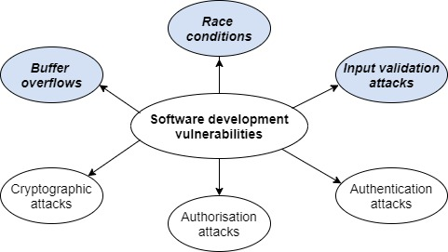
(5.2) Software development vulnerabilities

Slide 9
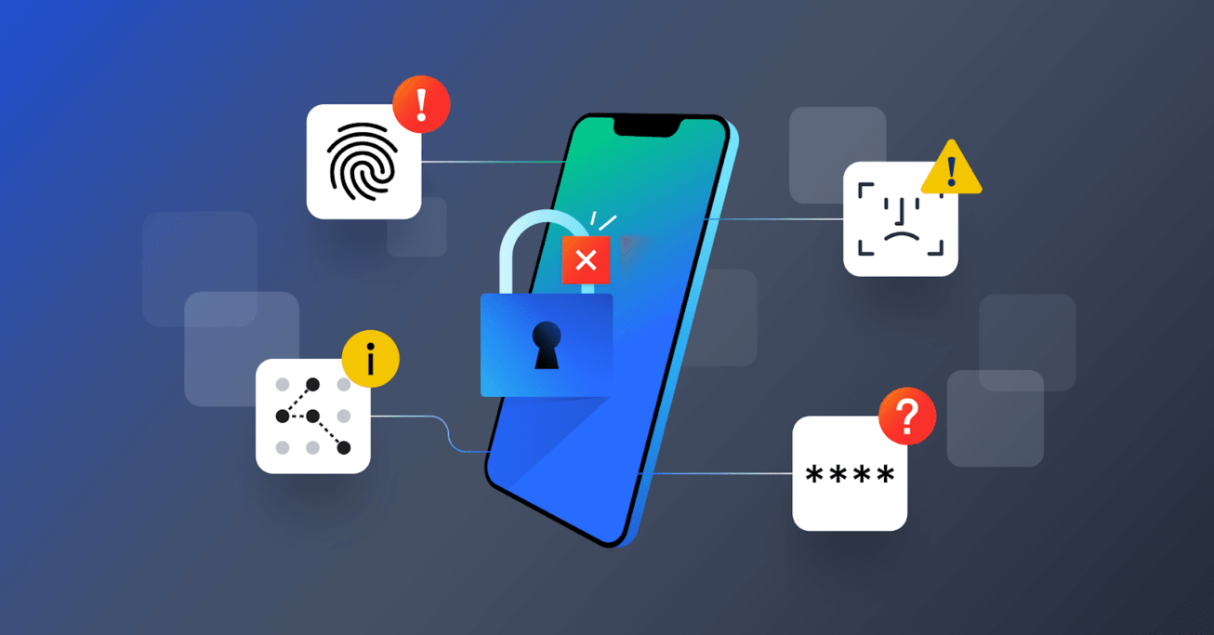
(5.2) Software development vulnerabilities
5.2.2 Authentication and authorisation attacks
Authentication/authorisation attacks aim to access resources or privileges without permission.
These are not caused by coding flaws, but by illegitimate access attempts.
Authentication attack: attacker pretends to be a valid user — strong passwords help prevent this.
Authorisation attack: attacker tries to access functions or data they aren’t allowed to (e.g. banking access).
Network monitoring should be reviewed regularly to catch access-related breaches.

Slide 10
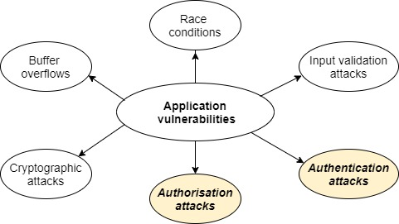
(5.2) Software development vulnerabilities
Application vulnerabilities

Slide 11
(5.2) Software development vulnerabilities
Activity
Watch the following video:
Title: The Five Stages of Vulnerability Management.
Link: https://www.youtube.com/watch?v=LkAptpCZDlc
Time allocation: 04:19

Slide 12
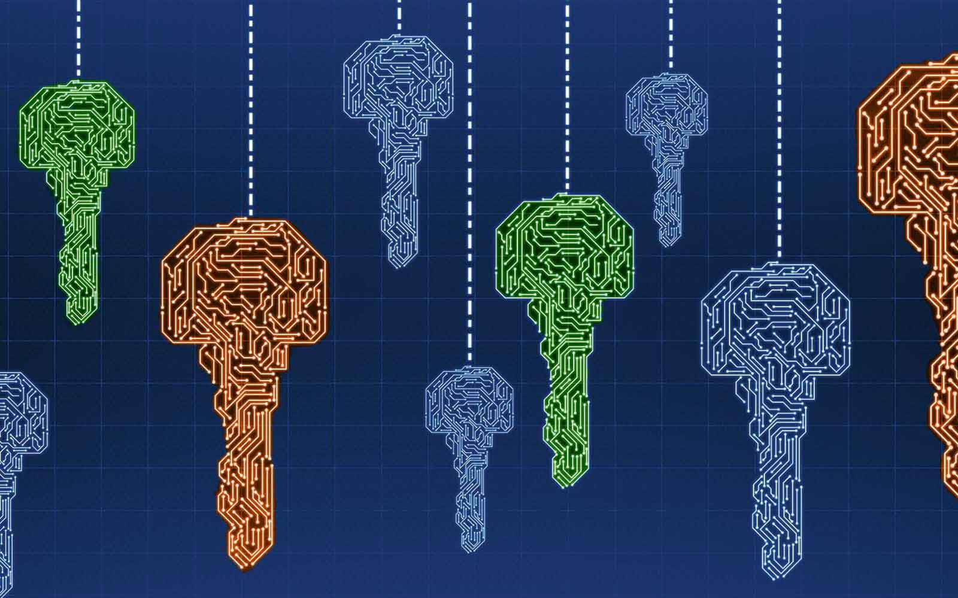
(5.2) Software development vulnerabilities
5.2.3 Cryptographic attacks
c attacks are rare if trusted algorithms are used.
Always ensure encryption keys can be changed if compromised.
Major risks arise from:
Poor implementation of cryptographic systems
Custom-built algorithms, which are often insecure.

Slide 13
(5.3) Web, database and application security
5.3.1 Web security
Client-side attacks
Exploit weaknesses on the user’s device or rely on social engineering.
Common methods:
Cross-site scripting (XSS): injects malicious script into web pages.
Cross-site request forgery: auto-executes actions using a user's existing login session.
Clickjacking: tricks users into clicking disguised malicious controls.
Browser updates help reduce risk.

Slide 14
(5.3) Web, database and application security
Server-side attacks
Caused by poor software development, wrong permissions, or unprotected backups.
Common risks:
Lack of input validation: can expose restricted server files — solved by filtering special characters.
Insecure configuration files: may reveal database credentials.
Extraneous files: old dev files and backups should be removed or secured.

Slide 15
(5.3) Web, database and application security
5.3.2 Database security
Organisations are legally obligated to protect sensitive personal data in databases.
Four main database security issues:
Protocol issues – flaws in communication methods with the database.
Unauthenticated access – users gain entry without valid credentials.
Privilege escalation – users gain more access than they are authorised for.
Arbitrary code execution – attackers run harmful code within the database system.

Slide 16
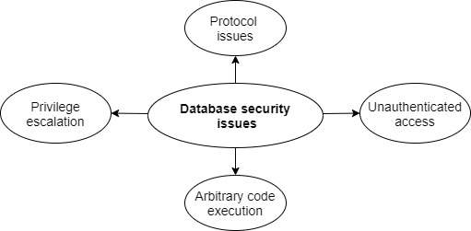
(5.3) Web, database and application security
Database security issues

Slide 17
(5.3) Web, database and application security
Protocol issues:
Caused by vulnerabilities in database communication protocols (e.g. buffer overflows).
Protection tips:
Use the latest database software.
Control network access to the database.
Limit accounts and privileges carefully.
Unauthenticated access:
Allowing database queries without credentials is a major risk.
Only authenticated/authorised users or processes should access the database.

Slide 18

(5.3) Web, database and application security
Arbitrary code execution:
Exploits weaknesses in SQL.
Prevent with secure coding and updated database software.
Privilege escalation:
Intruders submit SQL commands to gain higher access rights.
Admins must enforce appropriate access levels and monitor user privileges regularly.

Slide 19
(5.3) Web, database and application security
Activity
Watch the following video:
Title: The Dangers of a Data Breach.
Link: https://www.youtube.com/watch?v=0kK902-ZvNM&t=51s
Time allocation: 02:00

Slide 20
(5.3) Web, database and application security
5.3.3 Application security tools
Sniffers:
Monitor network traffic to/from applications.
Some generate diagrams showing traffic patterns and destinations.
Web application analysis tools:
Detect issues like weak permissions, outdated software, and unnecessary files.
Manual verification of reported issues is required before acting.

Slide 21
(5.3) Web, database and application security
Fuzzers:
Test apps with random inputs to uncover hidden bugs or vulnerabilities.
Help identify unexpected behaviour or crashes.
Enhance application security by:
Following secure coding practices
Monitoring for client-side and server-side issues
Securing databases
Applying the principle of least privilege
Keeping software up to date
Use application security tools to monitor data flow and detect vulnerabilities.

Slide 22
(5.3) Web, database and application security
Activity
Study the following article:
Title: Best 10 Packet Sniffer and Capture Tools.
Link: https://www.dnsstuff.com/packet-sniffers
Summarise the “packet sniffing best practices”; briefly explain how sniffer software is used by hackers; and suggest how IT staff can protect their organisation from hackers who use packet sniffers.
Time allocation: 15 minutes

Slide 23

(5.4) Conducting a security assessment
5.4.1 Vulnerability assessment
Vulnerability assessment tools detect weaknesses in platforms and applications.
The process has two main stages:
Mapping and discovery:
Active discovery: checks each IP address (slow).
Passive scanning: monitors network traffic to find active devices.

Slide 24

(5.4) Conducting a security assessment
2) Scanning:
Unauthenticated scan: finds open ports, services, OS, and apps.
Authenticated scan: uses admin credentials to gather deeper system info (e.g. config files, patches).
Agented scan: installs a small agent on each host, no extra credentials needed.
Application scan: deeply scans specific apps or technologies.

Slide 25

(5.4) Conducting a security assessment
Cloud and virtualisation challenges:
Cloud providers may restrict scans or change IPs with new deployments.
Containers require specialised tools due to dynamic scaling.

Slide 26
(5.4) Conducting a security assessment
5.4.2 Penetration testing
Penetration testing simulates hacker techniques to find and fix security flaws.
Typically done by external testers using real-world attack tools.

Slide 27
(5.4) Conducting a security assessment
Five stages:
1. Scoping:
Define what, when, and how testing will be done.
Agree on procedures for handling discovered vulnerabilities.
2. Reconnaissance (Recon):
Gather info about the organisation, systems, and environment.
3. Discovery:
Use vulnerability tools to find open ports, services, and potential weaknesses.
May lead to additional research.

Slide 28

(5.4) Conducting a security assessment
4. Exploitation:
Attempt to exploit identified vulnerabilities.
More testing may follow if new issues emerge.
5. Reporting:
Document testing process, findings, and successful exploit attempts.
Highlight high-risk issues and actionable threats.

Slide 29
(5.4) Conducting a security assessment
Activity
Watch the following video:
Title: A day in the life of a Penetration Tester.
Link: https://www.youtube.com/watch?v=_NVxgQdA45g
Time allocation: 03:42

Slide 30
(5.4) Conducting a security assessment
Types of Penetration Testing:
Black-box testing: Tester has no prior knowledge, simulates real hacker behaviour.
White-box testing: Tester has full access to system details to find specific vulnerabilities.
Grey-box testing: Tester has limited information about the environment.

Slide 31
(5.4) Conducting a security assessment
Internal vs External Testing (two definitions):
By location:
Internal: from inside the network.
External: targets internet-facing systems.
By role:
Internal: done by in-house staff.
External: done by a third party.
Clarify the definition used when referring to internal/external tests.

Slide 32

(5.4) Conducting a security assessment
Penetration Testing Targets:
Web applications
Networks
Hardware

Slide 33
(5.4) Conducting a security assessment
Types of Testing:
Network testing: Broad scope (hosts, web apps, techniques); often time-limited and surface-level.
Application testing:
Needs specialised tools.
Static analysis: inspects source code.
Dynamic analysis: tests the app while running.
Physical testing: Tests locks, alarms, and physical access controls.
Social engineering: Includes phishing and tailgating attempts.
Hardware testing:
Tests device, firmware, mobile apps, and APIs.
UART/JTAG debug ports may allow unauthenticated access.

Slide 34
(5.4) Conducting a security assessment
Challenges:
Cloud provider restrictions on testing.
Shortage of skilled testers.
Bug bounty programs offer rewards for reported vulnerabilities within defined testing scopes.

Slide 35
(5.4) Conducting a security assessment
5.4.3 How realistic is your test environment?
Basic Evaluation of Security:
Run vulnerability tools and penetration tests alongside daily security tools.
Ensure IDS, firewalls, and anti-malware detect and report test ‘attacks’.
Use alerting systems to notify of attempted breaches.
Realistic Testing:
Tests should simulate real attackers for accurate results.
If testing could affect live systems, use a mirrored (replicated) test environment, ideally in the cloud.

Slide 36
(5.4) Conducting a security assessment
Attack Surface:
Your attack surface changes over time (e.g. after software updates).
Regular retesting is essential, using the latest attacker tools.
Red vs Blue Teams:
Red team: plays the role of attacker.
Blue team: defends, monitors, and documents red team activities.
Purple team: oversees and coordinates both teams to improve security.

Slide 37
(5.4) Conducting a security assessment
Activity
Study the following article:
Title: The Roles of Red, Blue and Purple Teams.
Link: https://www.advania.co.uk/blog/security/understanding-the-roles-of-red-blue-and-purple-security-teams/
Time allocation: 15 minutes

